Slide 1

Internet Technologies
ITI & XI-IT
Lesson 1: HTML
Henrik Lange

Slide 2
Agenda
What is HTML
HTML, CSS & JavaScript
A General Template
Elements and Attributes
HTML, Head & Body
The DOM
Headers and paragraphs
Images
Videos
Lists
Tables
Divs and spans
HTML Entities
Titles and favicons
Backgrounds
Colors and sizes
ID’s and Classes

Slide 3
What is HTML?
Hyper Text Markup Language
Text centric
Hypertext: functional
Markup: How it looks
A language that defines how functional text looks

Slide 4
HTML CSS & JavaScript
A browser only understands HTML, CSS & JavaScript
All variations are translated to these language
Frameworks are pre-written code you can call
Most media types are supported by browsers
There are minor differences in browser interpretation

Slide 5
HTML CSS & JavaScript
HTML Defines the structure and ties the 3 together
CSS is only concerned with how things look
Once HTML and CSS is loaded, the browser creates the DOM
JavaScript can manipulate the DOM after it is created
JavaScript is Turing complete; HTML and CSS is single-purpose
The languages are not limited to browsers

Slide 6
A General Template
<!DOCTYPE html> <html> <head> <title>Title of the document</title>
<meta name="viewport" content="width=device-width, initial-scale=1.0">
<script src="myscripts.js"></script>
<link rel="stylesheet" type="text/css" href="style.css"> </head> <!--Comment--> <body> <h1>Header</h1>
<p>General content</p>
<a href="url">A link</a>
</body> </html>

Slide 7
Elements and Attributes
<element attribute=“value”>
Element Content
</element>

Slide 8
HTML, Head & Body
<html> wraps the <head> and <body>
<head> contains functional, invisible content
<body> contains the actual document

Slide 9

The HTML DOM
Document Object Model
Right-click on any page in Chrome and select “inspect”
Source: https://www.w3schools.com/js/js_htmldom.asp

Slide 10
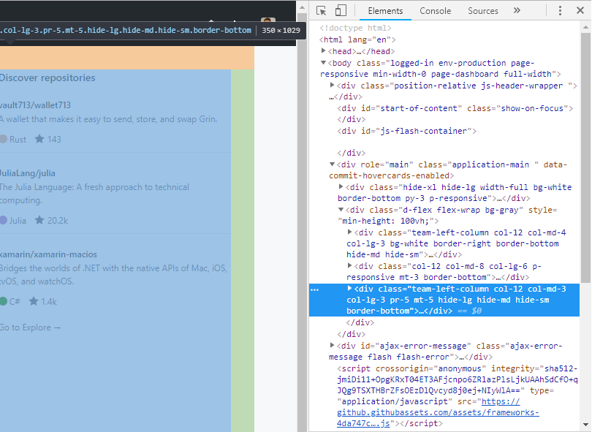
The HTML DOM
Hover over DOM element to highlight in document
Source: https://www.w3schools.com/js/js_htmldom.asp

Slide 11
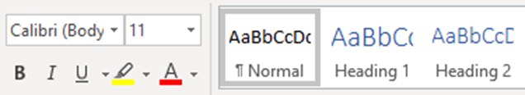
Headers & Paragraphs
<b> <i> <u>
<p>
<h1>
<h2>
Document elements are comparable to those of MS Word
The style attribute contains CSS – we will get back to that
Header1
Header2
Some text with bold, italic and underlined text
Even a link
<h1>Title</h1>
<h2>Header</h2>
<p>
Some text with <b>bold</b>, <i>italic</i> and <u>underlined</u> text
<br/>
<a href="URL">Even a link</a>
</p>
=

Slide 12
Links
<a href="URI" title=“hover description"/>
title: is text the browser can display when the mouse hovers over the image
Can contain any elements that should be part of the clickable link.
CSS note:
Style=“decoration = none;”

Slide 13
Images
<img src="URI" alt="description" title=“hover description"/>
<img> element has no end tag and is terminated with /
alt: text to display if image is not loaded
title: is text the browser can display when the mouse hovers over the image
width and height can be set with HTML attributes
width="300px" height="400px"
You should use CSS instead

Slide 14
Videos
Local
<video width="320" height="240" poster="image.gif" autoplay controls> <source src="video.mp4" type="video/mp4"> <source src="video.ogg" type="video/ogg"> Your browser does not support the video tag. </video>
YouTube
<iframe width="420" height="315" src="https://www.youtube.com/embed/videoId?autoplay=1"> </iframe>

Slide 15
Lists
<ul>
<li>Bullet</li>
<li>Point</li>
<li>List</li>
</ul>
Bullet
Point
List
Numbered
List
With
Items
<ol>
<li>Numbered</li>
<li>List</li>
<li>With</li>
<li>Items</li>
</ol>

Slide 16
Tables
Name | Gender | Age
Mads | Male | 21
Annie | Female | 24
<table>
<tr>
<th>Name</th>
<th>Gender</th>
<th>Age</th>
</tr>
<tr>
<td>Mads</td>
<td>Male</td>
<td>21</td>
</tr>
<tr>
<td>Annie</td>
<td>Female</td>
<td>24</td>
</tr>
</table>
No column definition
Tables contain rows
Rows contain cells
Just like DB content!
Attributes to merge cells
Rowspan
Colspan

Slide 17
Divs and Spans
A <div> is of the type
“block”
A <span> is
Of the type
“inline”
The <div> element is the most popular way to group and sort elements that don’t adhere to a specific HTML element type.

Slide 18
Forms
<form action=“url.html” method=“GET”>
<fieldset>
<legend>Explanation</legend>
<input type=“text” placeholder=“write here”/>
<input type=“password” tabindex=“1” autofocus/>
<input type=“file” name=“file”/>
<input type=“submit” tabindex=“2” >
<button></button>
</fieldset>
</form>

Slide 19
Forms input types
Common
Text
Password
Submit (use button element instead)
Reset
Button (use onclick attribute)
Checkbox
Radiobuttons
Dropdown menu (select option)
Hidden
HTML 5 additions
Color
Date
Email
Month
Number
Range
Search
Tel
Time
Url
Week

Slide 20
Forms input attributes
Common
Type
Name
Autofocus
Tabindex
Placeholder
Value
Common HTML attributes, not specific for inputs
Class
Id

Slide 21
HTML Entities
<br/> is a linebreak
No linebreaks from text are printed by default
&nbsp; is a space
Only single spaces from text is printed by default
Complete reference:
https://dev.w3.org/html5/html-author/charref

Slide 22
HTML Entities
Sign | Description | Entity Name | Entity Number
 | Space | &nbsp; | &#160;
< | Less than | &lt; | &#60;
> | Greater than | &gt; | &#62;
& | Ampersand | &amp; | &#38;
" | Double quotation mark | &quot; | &#34;
' | Single quotation mark/apostrophe | &apos; | &#39;
¢ | Cent | &cent; | &#162;
£ | Pound | &pound; | &#163;
¥ | Yen | &yen; | &#165;
€ | Euro | &euro; | &#8364;
© | Copyright | &copy; | &#169;
® | Registered trademark | &reg; | &#174;

Slide 23

Titles and Favicons
<title>Google Maps</title>
<link rel="shortcut icon" type="image/png" href="/favicon.png"/>
Both should be in the HTML Head

Slide 24
Backgrounds
<body background="bgimage.jpg">
<body bgcolor="#E6E6FA">

Slide 25
Colors and Sizes
Blue, Red, White, Black
Hex: #AA00FF
rgb(255,0,0)
rgba(255,0,0,0.5)
a is for alpha

Slide 26
ID’s and Classes
<div id="someId" class="classA classB">
Any element can have class and id
Multiple elements can be in the same class
Multiple classes can be set to the same element
Multiple classes are separated by space
An element can only have one ID
An ID can only be used for one element
ID’s and classes are used by the CSS and JavaScript to reference the elements later

Slide 27

Font Awesome
Use in your HTML by including this in the head:
<link rel="stylesheet" href="https://use.fontawesome.com/releases/v5.6.3/css/all.css" integrity="sha384-UHRtZLI+pbxtHCWp1t77Bi1L4ZtiqrqD80Kn4Z8NTSRyMA2Fd33n5dQ8lWUE00s/" crossorigin="anonymous">
Instructions/Link can be found here:
https://fontawesome.com/start
See all free icons
https://fontawesome.com/icons?d=gallery&m=free
Use an icon like this
<i class="fas fa-arrow-down"></i> =
Can be colored and sized like fonts
All types of icons, including jokes, tools, arrows, logos, etc.

Slide 28

Font Awesome

Slide 29
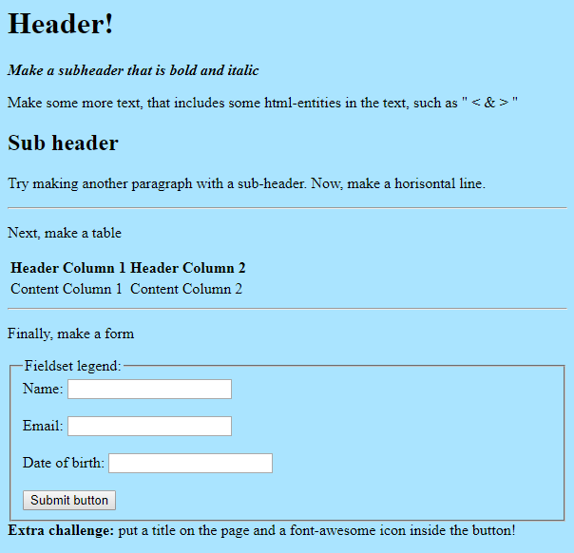
Exercise
And afterwards, we will continue with CSS

